Slide 1
LECTURE # 05 LANDSCAPE ARCHITECTURE & GARDEN DESIGN

Slide 2
What is Landscaping?
Landscape is more than just scenery. “Land” means both a place and the people living there. “Scape” means “to shape”, and also mean association, partnership.

Slide 3
What is Landscaping?
The design of outdoor spaces of residences, commercial and any institutional area in order to achieve environmental and aesthetic standards is known as landscaping.
It refers to any activity that modifies the visible features of an area of land, including:
Living elements flora or fauna.
Natural elements such as landforms, elevation, or bodies of water;
Human elements such as structures, buildings, fences or other material objects created/installed by humans; and
Abstract elements such as the weather and lighting conditions.

Slide 4
Landscape Architecture
The name "landscape architecture" was invented by a Scotsman in 1828. It uses the ancient skill of garden designers (to compose landform with water, vegetation, structures and paving) and applies this skill to the man-made landscape.
As Sir Geoffrey Jellicoe wrote in ”The landscape of man” (1975): 'It is only in the present century that the collective landscape has emerged as a social necessity. We are promoting a landscape art on a scale never conceived of in history'. Landscape architecture is set fair to become the mother of the arts.

Slide 5
Scope of Landscape Architecture
Landscape architecture involves the systematic investigation of existing social, ecological, and geological conditions and processes in the landscape. The scope of the profession includes:
Urban Design
Site Planning
Environmental Restoration
Parks and Recreational Planning

Slide 6
Scope of Landscape Architecture
Urban Design
An urban establishment has to contain strategic landscaping elements integrated in its composition. These elements include green belts along roads, hard and soft shading devices, parks and pedestrian pathways.
In contrast to architecture, which focuses on the design of individual buildings, urban design deals with the larger scale of groups of buildings, streets and public spaces, whole neighborhoods and districts, and entire cities, with the goal of making urban areas functional, attractive, and sustainable.

Slide 7
Site Planning
The site of any residential, commercial and office building must be incorporated with landscaping elements like trees, creepers, plants and paved floors/walkways externally.
Environmental Restoration
Trees produce oxygen and reduce greenhouse effect. To keep environment healthy and carbon free plantation should always be given significant attention.
Parks and Recreation Planning
Recreational planning in form of parks, walk/jogging tracks, leisure outdoor sitting spaces contribute towards making an urban commodity more comfortable.

Slide 8
Key Elements of Landscape Architecture
Hardscape elements
The term hardscape is used to describe the construction materials which are used to improve a landscape by design.
A wide range of hard landscape materials can be used, such as brick, gravel, rock or stone, concrete, timber, bitumen, glass, metals, etc.
Hardscape can also describe outdoor furniture and other landscape products.

Slide 9
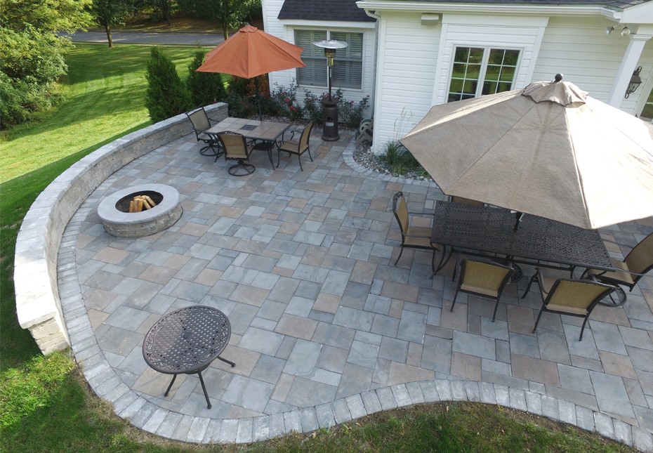
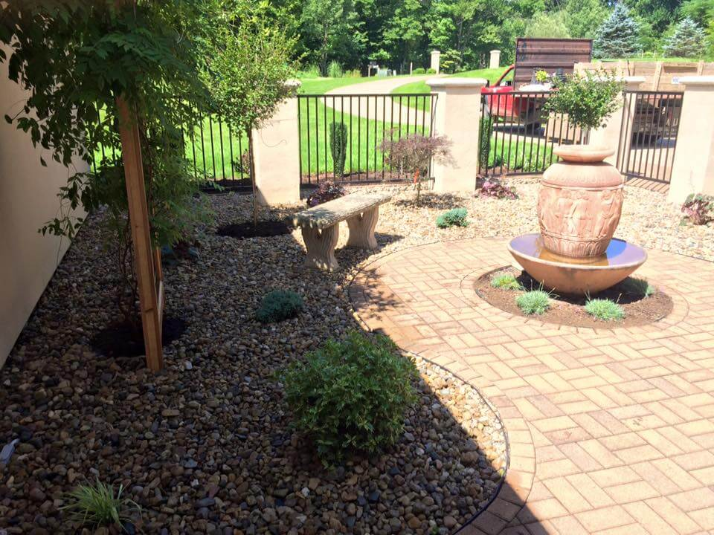
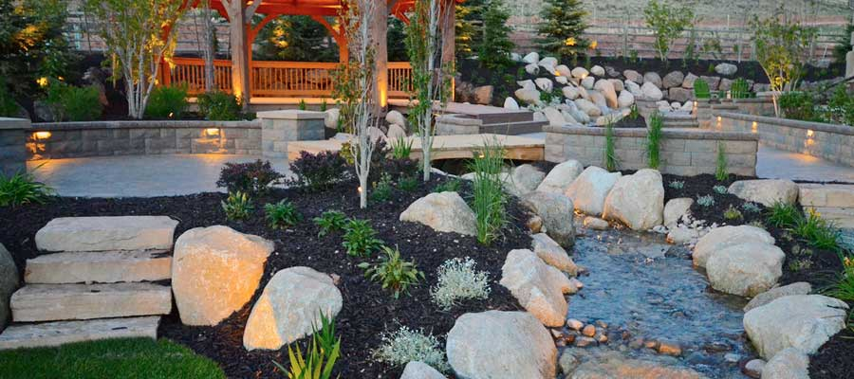

Slide 10
Key Elements of Landscape Architecture
Softscape elements
The term softscape is used to describe the vegetative materials which are used to improve a landscape by design.
The wide range of soft landscape materials include each layer of the ecological sequence: aquatic plants, semi- aquatic plants, field layer plants (including grasses & plants), shrubs and trees.
Trees may be:
Ornamental
Shady

Slide 11
Creepers
Shrubs
Climbers
Covered pathways

Slide 12
Key Elements of Landscape Architecture
Water Bodies
Water, which is a natural element, is also another most important and prominent landscape element.
Water bodies improve the quality and the worth of the site. It makes the site attractive.
The wide range of water bodies include fountains, pools, ponds, spouts and functional faucets, sprinkles, artificial waterfalls, etc.

Slide 13
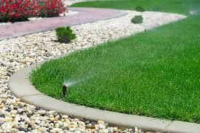
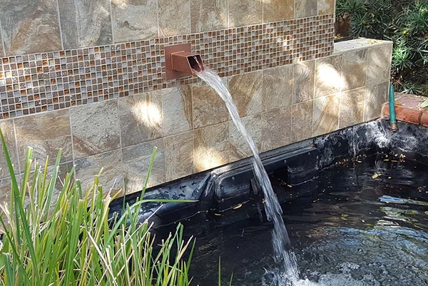

Slide 14
Key Elements of Landscape Architecture
Landmark
A Landmark is a recognizable natural or artificial feature used for navigation, a feature that stands out from its nears environment and is often visible from long distances. It may be:
Functional (e.g. Brick clock tower, Ghazeebo)
Ornamental

Slide 15
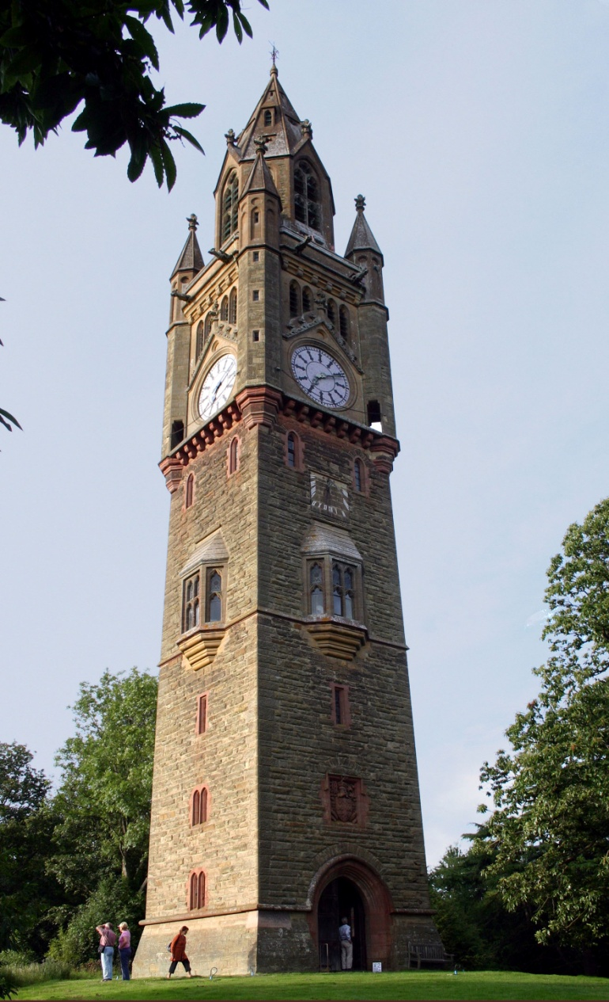
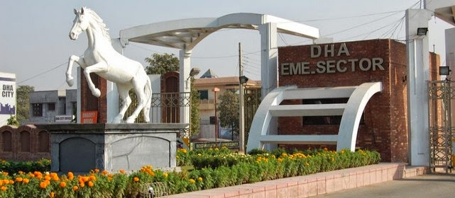

Slide 16
Energy-efficient Landscaping
The landscaping designed for the purpose of conserving energy is known as energy efficient landscaping.
The key purpose of plantation is to provide shade and reduce hear in our country. Any effort in this respect will help in reducing energy/ electricity consumption. This is referred as an energy-efficient landscaping technique.
Some of the other design techniques include:
Planting trees for the purpose of providing shade, which reduces cooling costs.
Planting or building windbreaks to slow winds near buildings, which reduces the heat.

Slide 17
Energy-efficient Landscaping
Wall sheltering, where shrubbery or vines are used to create a windbreak directly against a wall.
Green roofs that cool buildings.
Site lighting with full cut off fixtures, light level sensors, and high efficiency fixtures.
Local materials should be include to achieve cost effective landscape design.

Slide 18
Landscape Architecture & Garden Design
Landscape architect and garden designers are concerned for the planning and design of outdoor spaces.
The key difference is that landscape architects normally works for public clients while garden designers tend to work for homeowners.
The range of work undertaken by landscape architect extends from detailed design to broad scale landscape planning.

